Slide 1
Welcome to the Miguel Hernández University of Elche

Slide 3
Business, Economics, Legal Sciences, Communication, Statistics, Health Sciences Engineering, Biotechnology, Food Technology, Psychology, Physical and Sport Education, Fine Arts,
Political Sciences
4 campuses within a 50 km radius around Alicante
Alicante-Elche Airport
(ALC),
seaport of Alicante, train stations
1996
28 B
50 M
13 D

Slide 4
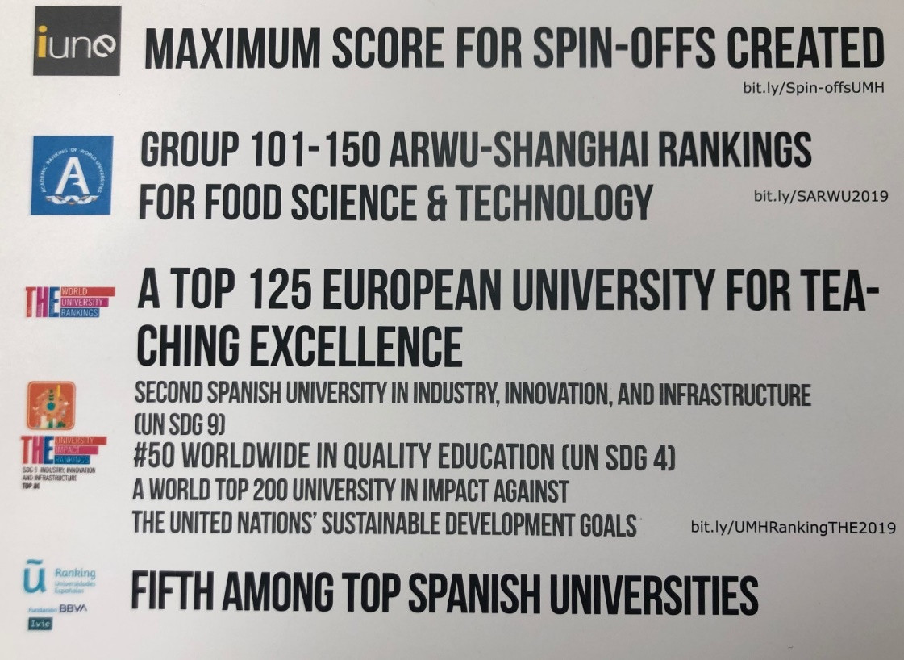
17,653 Students
Admin 463
37,700 Alumni
Support Projects 275
Faculty 1085
107,703,555€

Slide 5
663 International Agreements
317 incoming
284 outgoing
Erasmus+ Key Action 1: Mobility between Program Countries and with Partner Countries
Erasmus+ Key Action 2:
Capacity Building Program Strategic Partnerships Sports
Erasmus MUNDUS

Slide 6
5 Research Institutes
10 Research Centers
Institute of Neurosciences (IN)
70 Research Laboratories
3.13 spinoffs per 100 faculty Most productive Spanish university in creating technology-based companies (IUNE Observatory)
Institute of Research, Development and Innovation in Sanitary Biotechnology of Elche (IDiBE)
Institute of Bioengineering (IB)
25 functioning businesses founded from the transfer of knowledge of university research
(Scientific Park)
Statistics and Big Data
López Piñero Interuniversity Institute of Historical and Social Studies

Slide 7
Sport Sciences Research Center
APCOM (Motor Control and Learning)
BIOMEC (Biomechanics for Health and Sports Performance)
GICOM (Motor Behavior)
GIAFIS (Physical Conditioning and Health)

Slide 8
Development Cooperation
2005-19. Nemba Hospital. Health professional training programs in medical specialities that are almost nonexistent (Neurophysiology).
2012-19. Nemba School. Teaching 1500 children in primary and secondary school.
2011-19. Program of volunteers to train
Rwandan teachers in Nemba.
HE and health research in Mexico, Cuba, Colombia, Argentina, Brazil, Honduras, Peru, Paraguay, Nicaragua, Mozambique, Ghana, Gambia, Senegal, Democratic Republic of Congo and Ecuador.

Slide 9
Experimental Sciences
Social and Legal Sciences
Health and Social Sciences
Engineering of Elche
Engineering of Orihuela
Social and Legal Sciences
Elche
Orihuela
Fine Arts
Sant Joan
Medicine
Pharmacy
Altea

Slide 10
Faculty of Experimental Sciences.
Bachelors
Biotechnology
Environmental Science

Slide 11
Faculty of Social and Legal Sciences. Bachelors
Dual Bachelor's in Audiovisual Communication and Journalism
Dual Bachelor's in Law and Business Administration and Management
Business Administration and Management
Audiovisual Communication
Law
Business Statistics
Journalism
Labor Relations and Human Resources
Public Safety and Private Security

Slide 12
Faculty of Health and Social Sciences.
Bachelors
Psychology
Physical Activity and Sports Sciences

Slide 13
School of Engineering of Elche. Bachelors
Computer Engineering & Information Technologies
Electrical Engineering
Electronic Engineering and Industrial Automation
Mechanical Engineering
Telecommunications Technology Engineering

Slide 14
SCHOOL OF ENGINEERING OF ORIHUELA
Bachelors
Agro-Food & Environmental Engineering
Food Science and Technology

Slide 15
FACULTY OF SOCIAL AND LEGAL SCIENCES
OF ORIHUELA. Bachelors
Political Science and Public Administration
Business Administration and Management (Orihuela)

Slide 16
FACULTY OF MEDICINE
Bachelors
Medicine
Occupational Therapy
Physiotherapy
Podiatry

Slide 17
FACULTY OF PHARMACY
Bachelor
Pharmacy

Slide 18
FACULTY OF FINE ARTS
Bachelor
Fine Arts

Slide 19
We welcome your students and faculty
Erasmus+Programs
Study Abroad Programs
Direct enrollment (Free mover)
Research collaborations and networking

Slide 20
STUDENT LIFE
Sporting and leisure
Student Delegation
UMH libraries
UMH Intelligent Card
University dining halls
Area of Attention for Students with Disabilities

Slide 21
STUDENT EXCHANGE PROGRAMS
ERASMUS+
Destino SICUE
Dual Programs

Slide 22
Non-Erasmus Agreements

Slide 23
INTEGRATION SOCIAL PROGRAMS
Intensive Language Course
Buddy Program
UMH ERASMUS Club Experience

Slide 24
Thanks!
internacional@umh.es

